Slide 1
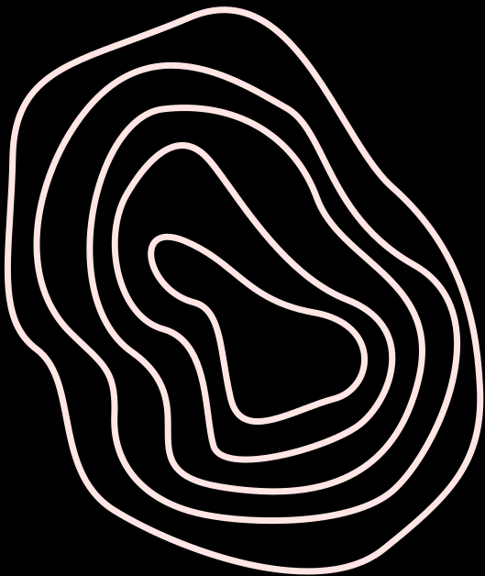







DATABASE
PROJECT

Slide 2
OUR TEAM
1.
Danielle Clason
2.
Maddie Lawrence

Slide 3
WHAT IS IT?
We created a database and a platform to be used in a school setting by admin, teachers, or students. Students can view schedules, drop class, see advisor info, and more. Instructors can change grades, modify sections, look at stats, look at advisee info and more. Admin can use CRUD in order to modify anything in the database.

Slide 4
TECHNOLOGY USED
We used VS Code and phpMyAdmin

Slide 5
PROJECT ARCHITECTURE
Frontend: HTML, CSS and JavaScript
Backend: Flask, Python, and SQL

Slide 6
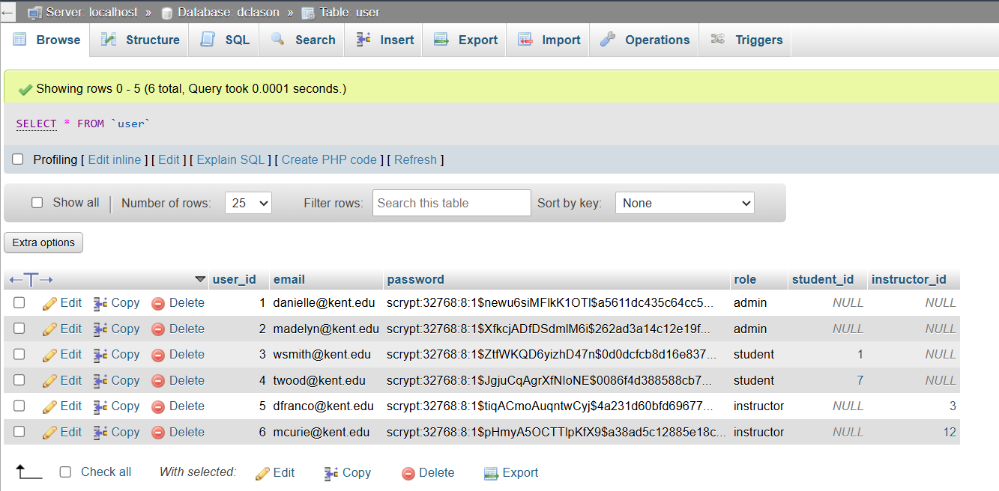
ENCRYPTED PASSWORDS

Slide 7
DEMO

Slide 8
CONCLUSION
Overall, this project was a completely new experience. Neither of us had experience using flask and integrating it into a web application however, we learned a lot during this process.
We feel satisfied with our application; It is a simple and easy to use application that has a lot of functionality.

Slide 9
THANK
YOU

